Slide 1

第六届强子谱和强子结构研讨会
Study multiquark states with strangeness
肖 楮 文（ Chu-Wen Xiao ）
广西师范大学（ Guangxi Normal University ）
合作者： Eulogio Oset, Juan Nieves, Bing-Song Zou, Jia-Jun Wu,
Li-Sheng Geng, Jun-Xu Lu, A. Feijoo, W. F. Wang
2023.8. 国科大，北京

Slide 2
Outline
Introduction
Pentaquark states
Tetraquark/XYZ states
Summary

Slide 3
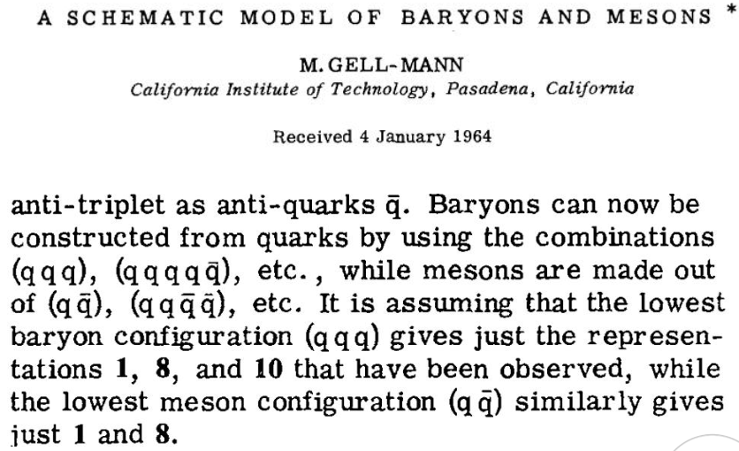
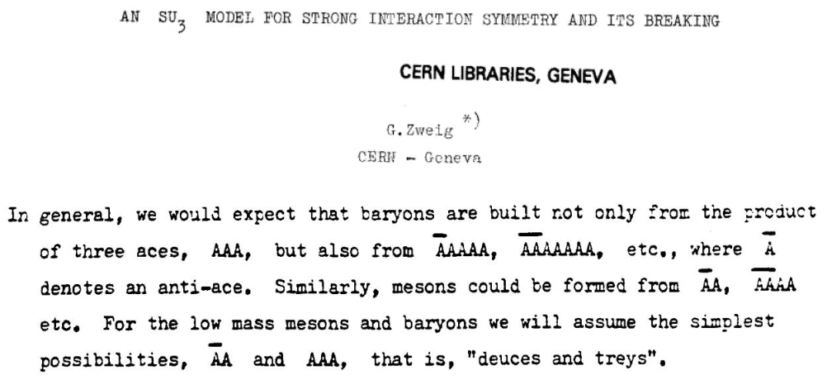
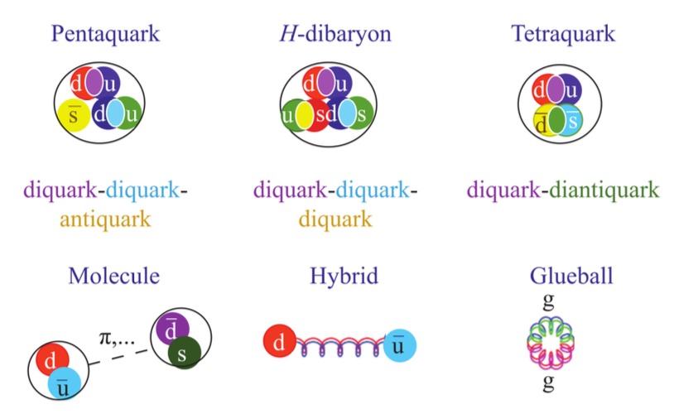
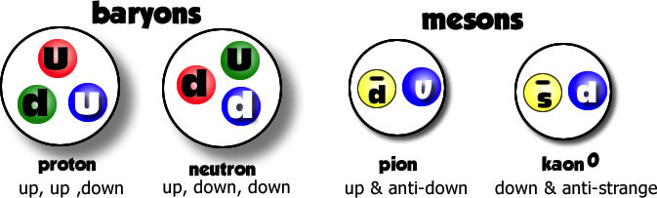
§1. Introduction
Quark model
Exotic States

Slide 4
H.-X. Chen, W. Chen, X. Liu and S.-L. Zhu, Phys. Rept. 639, 1 (2016)
A. Esposito, A. Pilloni and A. D. Polosa, Phys. Rept. 668, 1 (2016)
A. Hosaka, T. Iijima, K. Miyabayashi, Y. Sakai and S. Yasui, PTEP 2016, 062C01 (2016)
H. X. Chen, W. Chen, X. Liu, Y. R. Liu and S. L. Zhu, Rept. Prog. Phys. 80, 076201 (2017)
R. F. Lebed, R. E. Mitchell and E. S. Swanson, Prog. Part. Nucl. Phys. 93, 143 (2017)
A. Ali, J. S. Lange and S. Stone, Prog. Part. Nucl. Phys. 97, 123 (2017)
F.-K. Guo, C. Hanhart, U.-G. Meißner, Q. Wang, Q. Zhao and B.-S. Zou, Rev. Mod. Phys. 90, 015004 (2018)
R. A. Bricen ̃o, J. J. Dudek and R. D. Young, Rev. Mod. Phys. 90, 025001 (2018)
S. L. Olsen, T. Skwarnicki and D. Zieminska, Rev. Mod. Phys. 90, 015003 (2018)
M. Karliner, J. L. Rosner and T. Skwarnicki, Ann. Rev. Nucl. Part. Sci. 68, 17 (2018)
C. Z. Yuan, Int. J. Mod. Phys. A 33,1830018 (2018)
Y. R. Liu, H. X. Chen, W. Chen, X. Liu and S. L. Zhu, Prog. Part. Nucl. Phys. 107, 237 (2019)
N. Brambilla, S. Eidelman, C. Hanhart, A. Nefediev, C. P. Shen, C. E. Thomas, A. Vairo and C. Z. Yuan, Phys. Rept. 873, 1 (2020)

Slide 5
§2. Pentaquark states
Pc states
Pcs states
Theories
Experiments
Bing-Song Zou, Sci. Bull 66, 1258(2021)

Slide 6
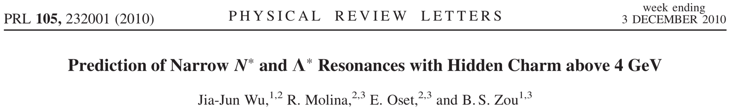

Predictions
Pc states
$$Θ^{+}(1540)$$
J. J. Wu, R. Molina, E. Oset and B. S. Zou, Phys. Rev. Lett. 105 (2010) 232001.
J. J. Wu, R. Molina, E. Oset and B. S. Zou, Phys. Rev. C 84 (2011) 015202.
W. L. Wang, F. Huang, Z. Y. Zhang and B. S. Zou, Phys. Rev. C 84 (2011) 015203.
Z. C. Yang, Z. F. Sun, J. He, X. Liu and S. L. Zhu, Chin. Phys. C 36 (2012) 6.
J. J. Wu, T.-S. H. Lee and B. S. Zou, Phys. Rev. C 85 (2012) 044002.
C. Garcia-Recio, J. Nieves, O. Romanets, L. L. Salcedo and L. Tolos, Phys. Rev. D 87 (2013) 074034.
CWX, J. Nieves and E. Oset, Phys. Rev. D 88 (2013) 056012.

Slide 7
In hidden charm strangeness sector
Pcs states
J. J. Wu, R. Molina, E. Oset and B. S. Zou, Phys. Rev. Lett. 105 (2010) 232001.
J. J. Wu, R. Molina, E. Oset and B. S. Zou, Phys. Rev. C 84 (2011) 015202.
H. X. Chen, L. S. Geng, W. H. Liang, E. Oset, E. Wang and J. J. Xie, Phys. Rev. C 93 (2016) 065203.
R. Chen, J. He and X. Liu, Chin. Phys. C 41 (2017) 103105.
E. Santopinto and A. Giachino, Phys. Rev. D 96 (2017) 014014.
C. W. Shen, J. J. Wu and B. S. Zou, Phys. Rev. D 100 (2019) 056006.
CWX, J. Nieves and E. Oset, Phys. Lett. B 799 (2019) 135051.
B. Wang, L. Meng and S. L. Zhu, Phys. Rev. D 101 (2020) 034018.

Slide 8
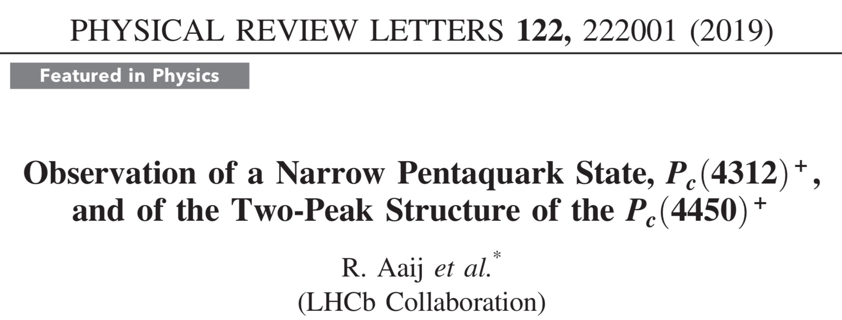

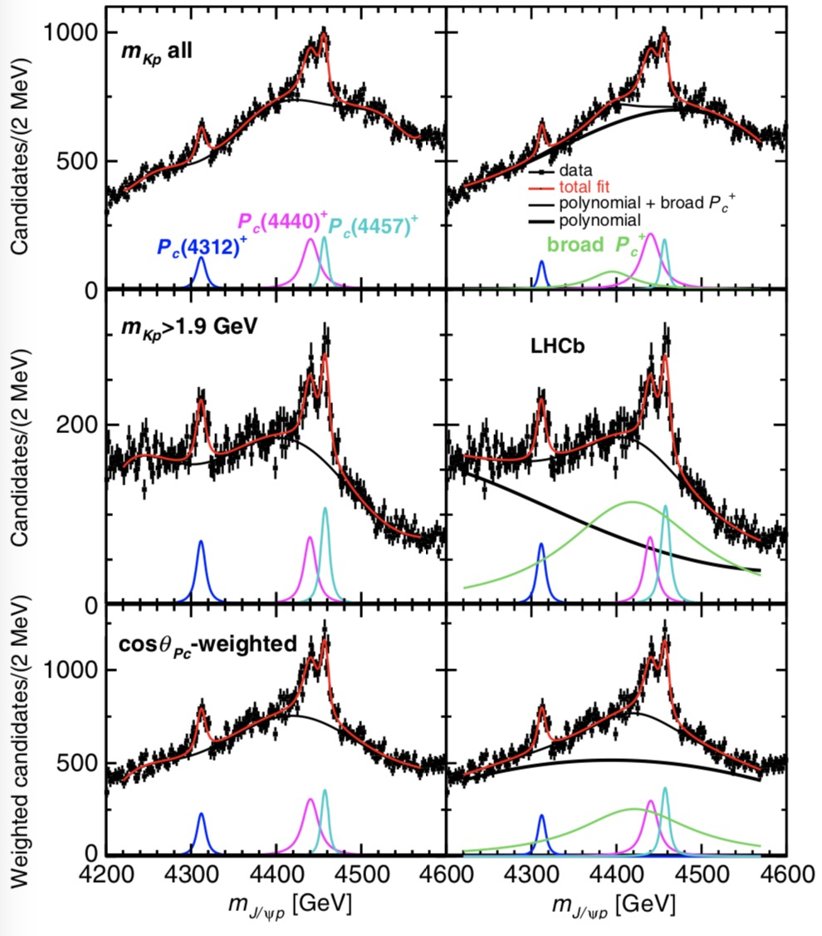
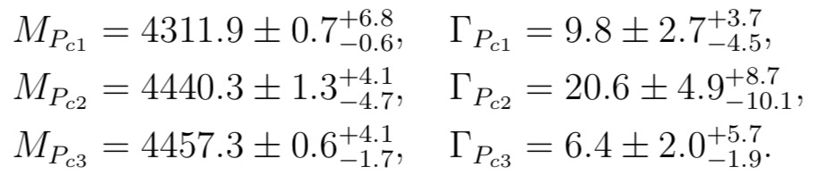


Findings for the Pc states
$$?$$
$$J^{P} ?$$
R. Aaij et al. (LHCb Collaboration), Phys. Rev. Lett. 115, 072001 (2015)

Slide 9
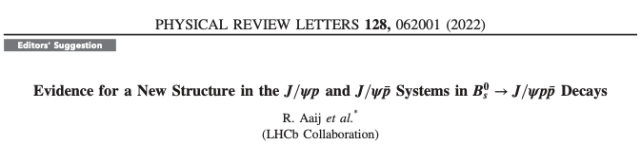
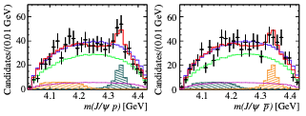


Slide 10
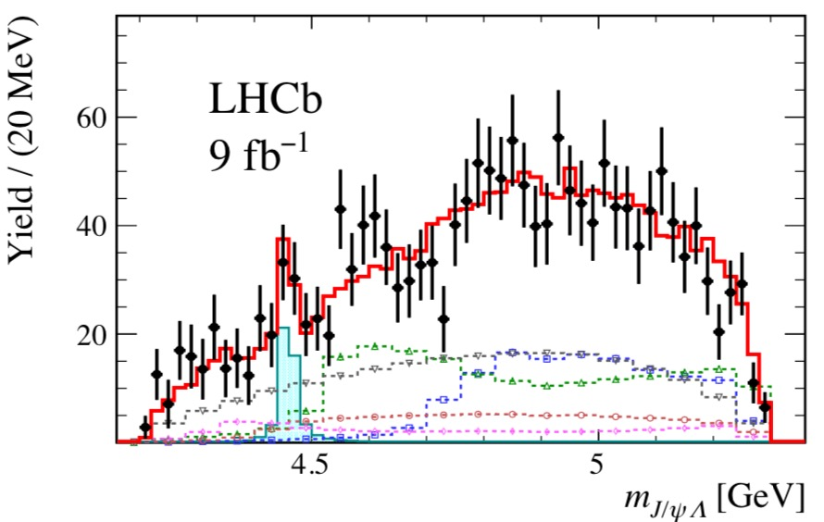

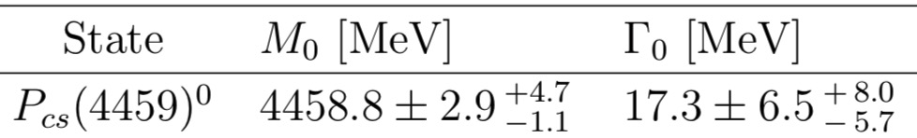
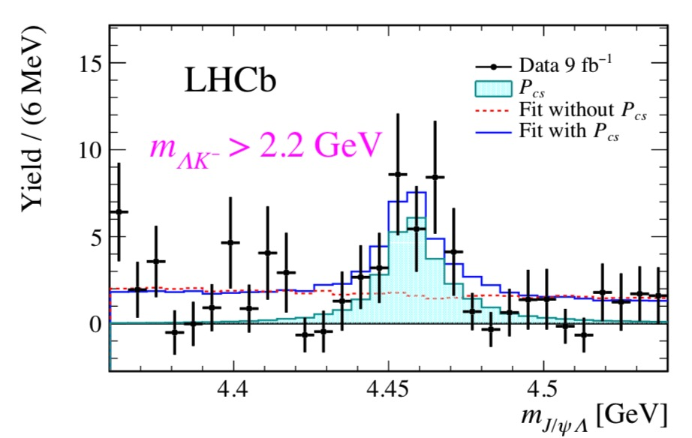
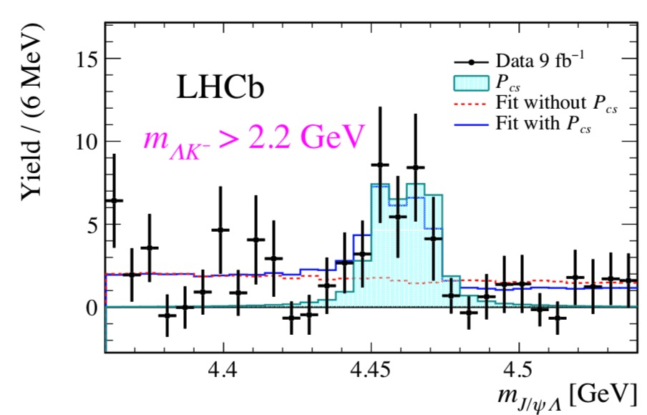

Findings for the Pcs state
R. Aaij et al. (LHCb Collaboration), Sci. Bull. 66 (2021) 1278-1287
$$J^{P} ?$$
B. Wang, L. Meng and S. L. Zhu, Phys. Rev. D 101 (2020) 034018.

Slide 11

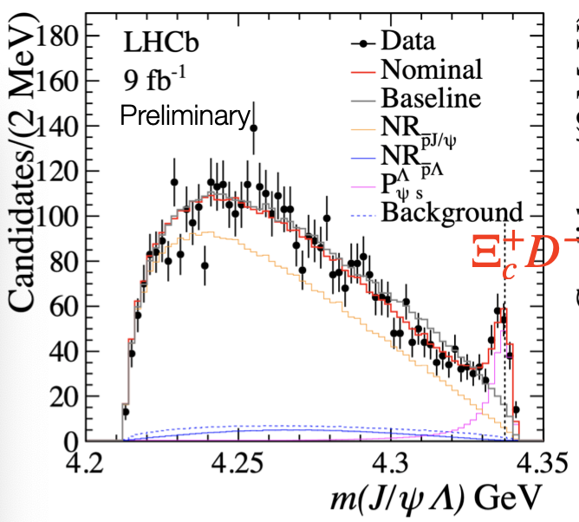
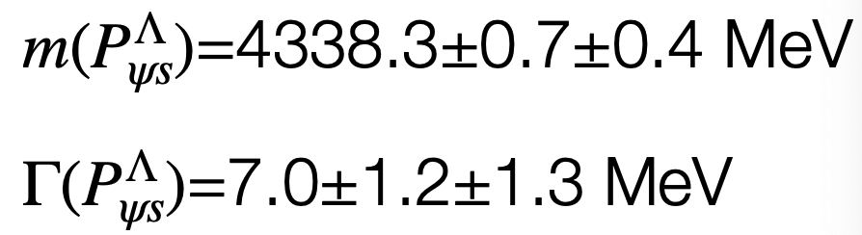


LHCb, Phys. Rev. Lett. 131, 031901 (2023)

Slide 12
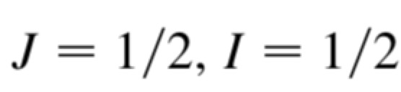
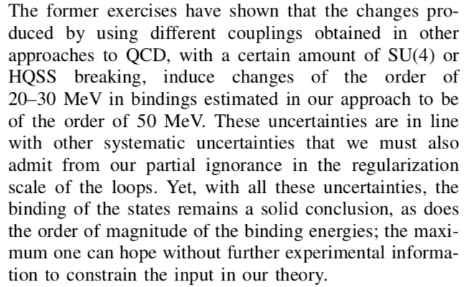
Our investigation for Pc
CWX, J. Nieves and E. Oset, Phys. Rev. D 88, 056012 (2013)

Slide 13
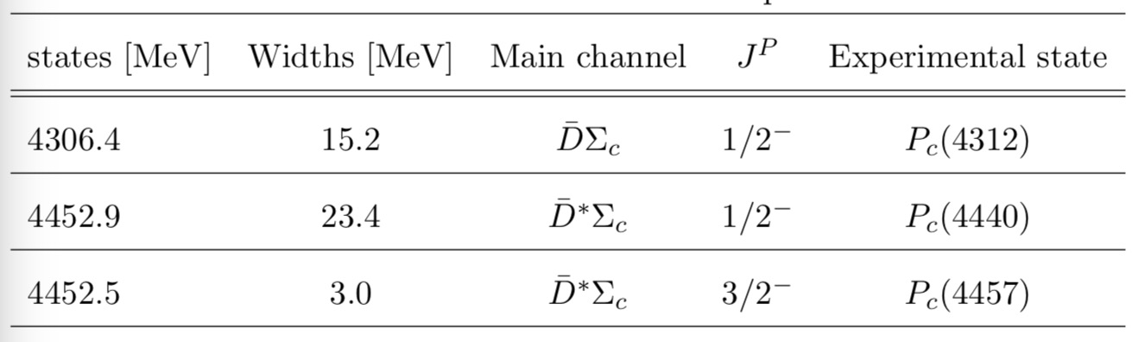
Further investigation after the findings
M. Z. Liu, Y. W. Pan, F. Z. Peng, M. S. Sanchez, L. S. Geng, A. Hosaka, and M. P. Valderrama, Phys. Rev. Lett. 122 (2019) 242001

Slide 14
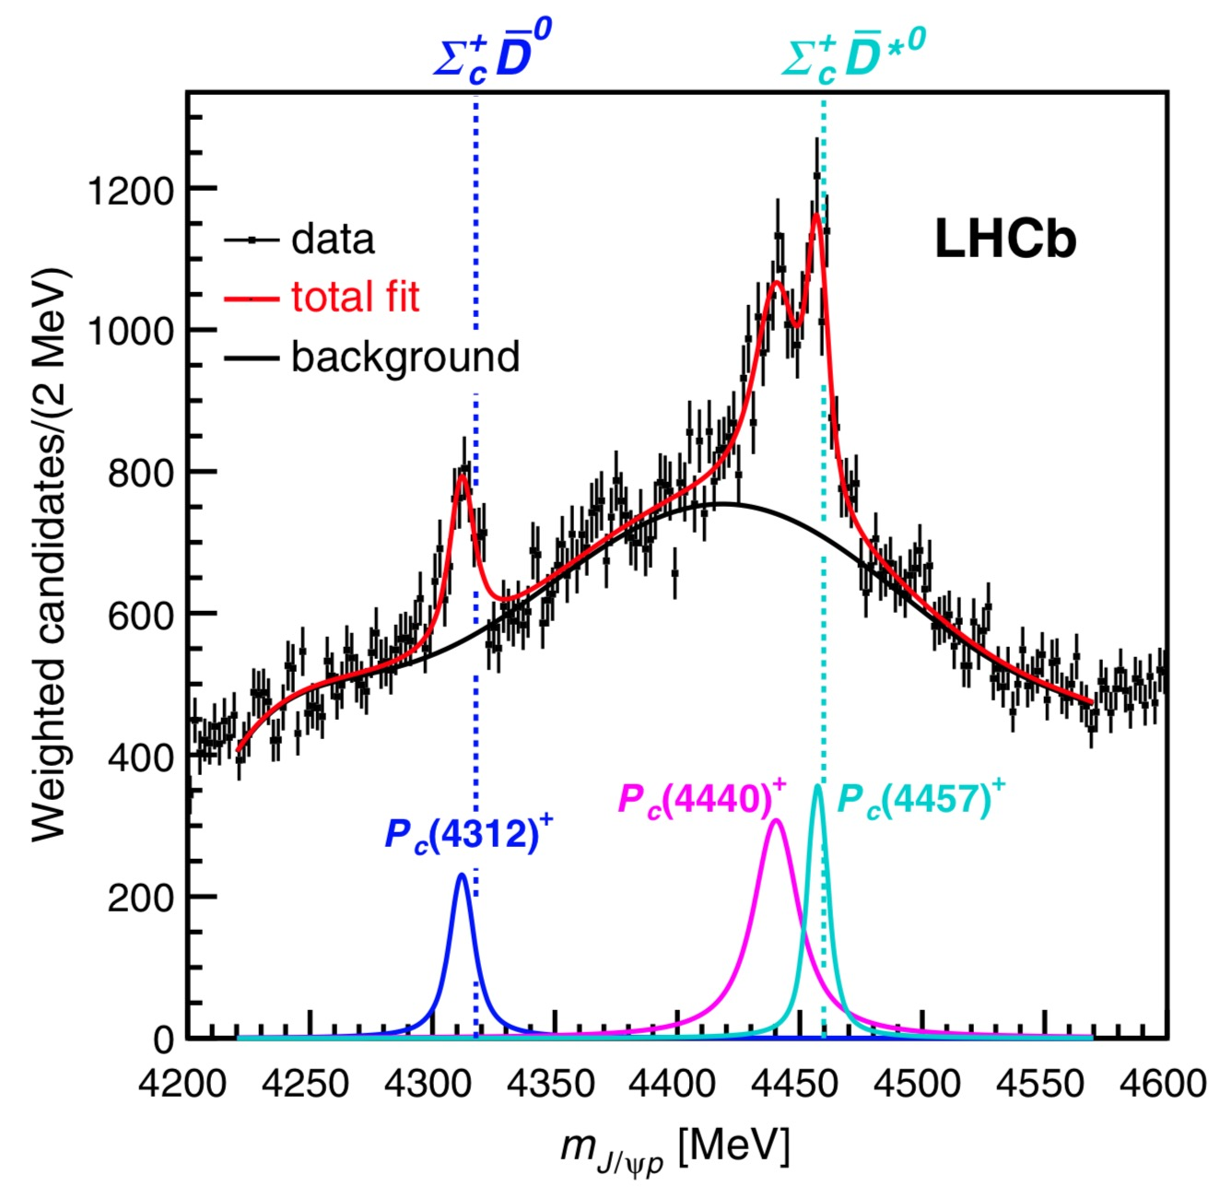












CWX, J. Nieves and E. Oset, Phys. Rev. D100 (2019) 014021

Slide 15
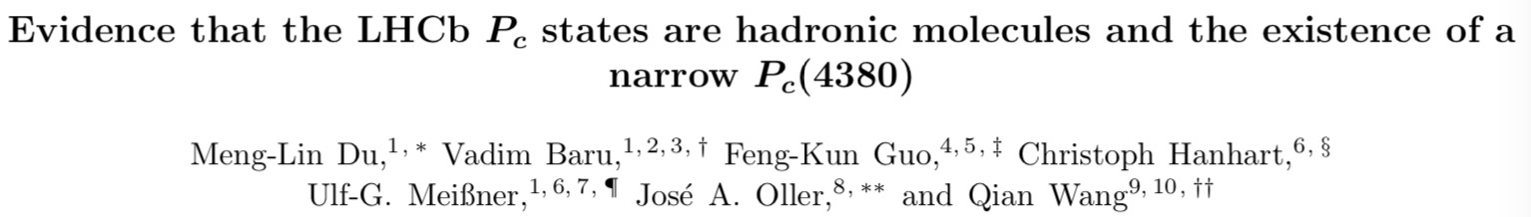
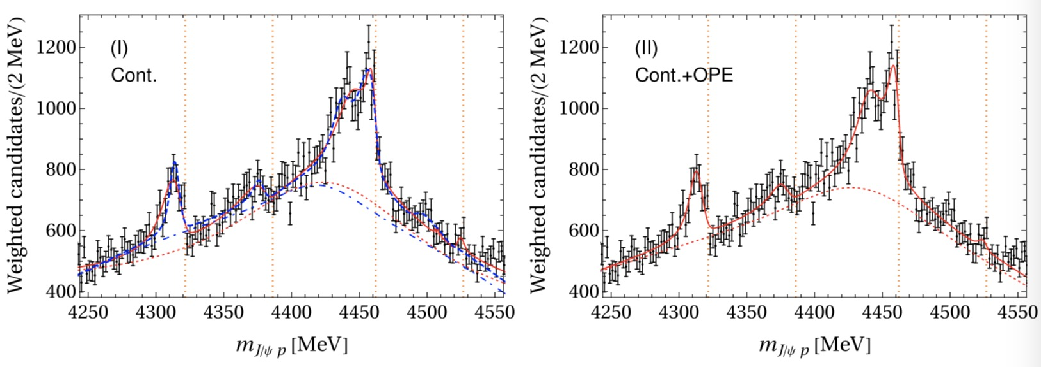

Slide 16
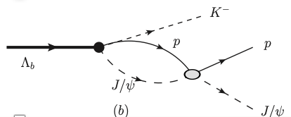


Next, we try to make a further investigation……
Indeed, this direct production is OZI suppressed!

Slide 17




Consider produced indirectly
CWX, J. X. Lu, J. J. Wu, and L. S. Geng, Phys. Rev. D102 (2020) 056018

Slide 18
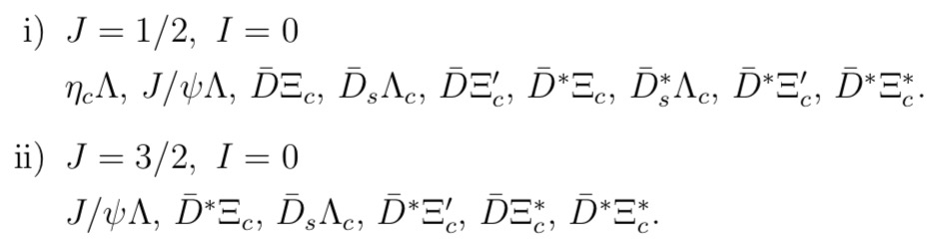
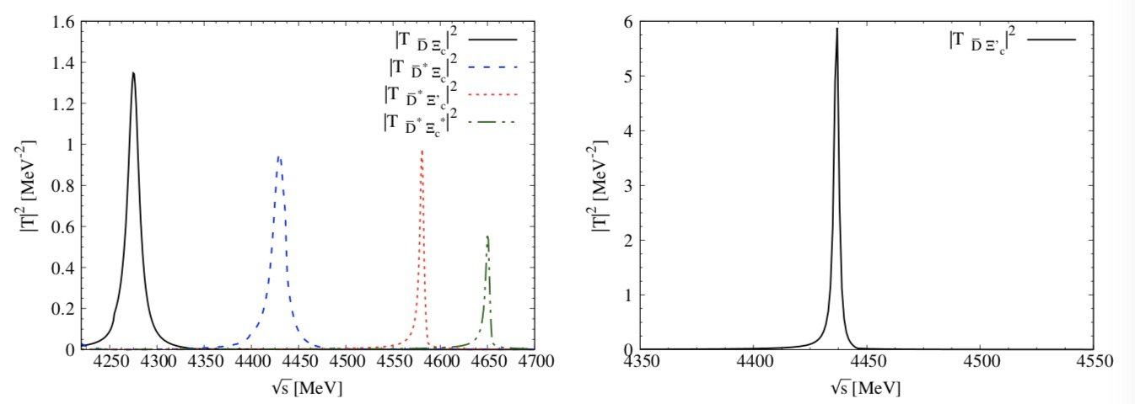
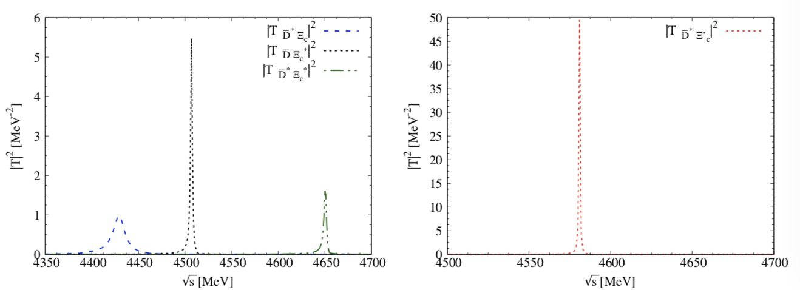
Further investigation for Pcs
HQSS
CWX, J. Nieves and E. Oset, Phys. Rev. D 100 (2019) 014021
CWX, J. Nieves and E. Oset, Phys. Lett. B 799 (2019) 135051.

Slide 19


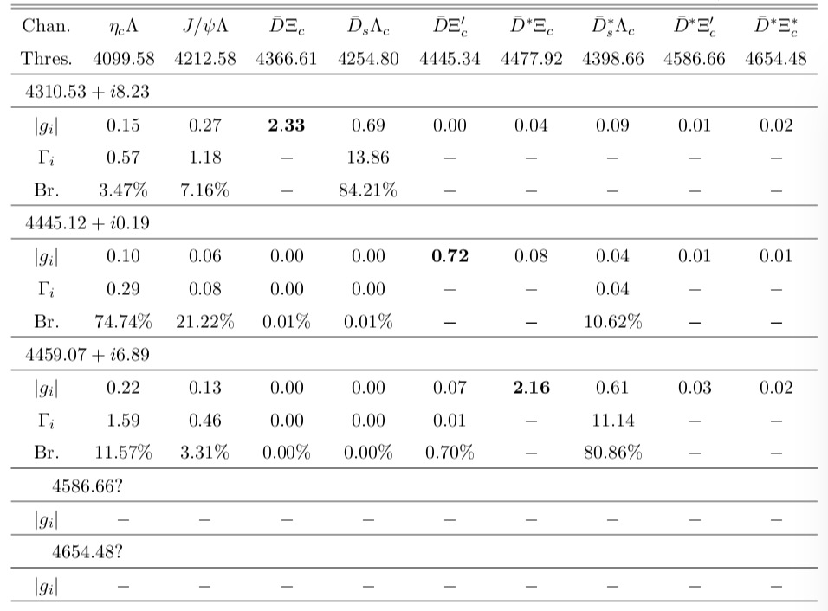



F. L. Wang and X. Liu, Phys. Lett. B 835, 137583 (2022).

Slide 20
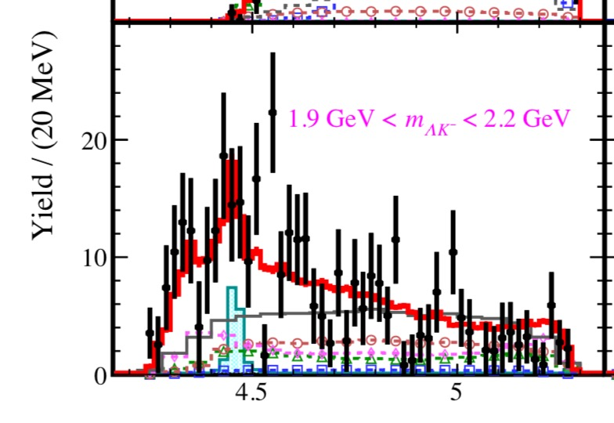

Slide 21



CWX, J. J. Wu and B. S. Zou, Phys. Rev. D 103 (2021) 054016.

Slide 22
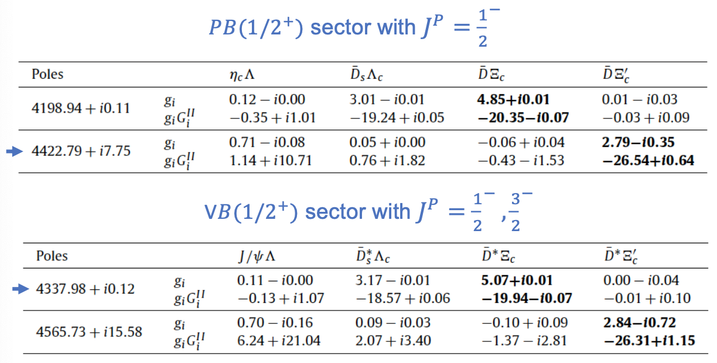
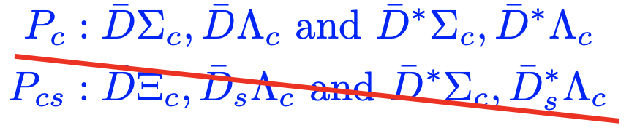
Recent investigation
A. Feijoo, W. F. Wang, CWX, J. J. Wu, E. Oset, J. Nieves, B. S. Zou, Phys. Lett. B 839 (2023) 137760

Slide 23
§3. Tetraquark/XYZ states
Zc states
Zcs states
Theories
Experiments

Slide 24
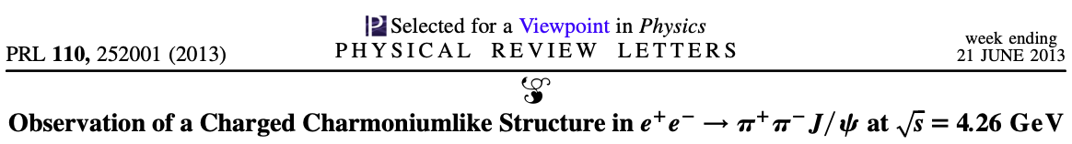
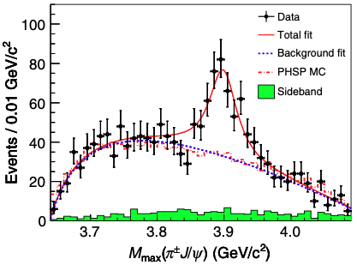
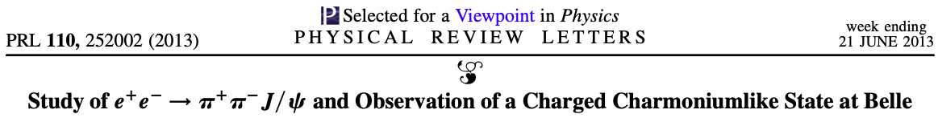
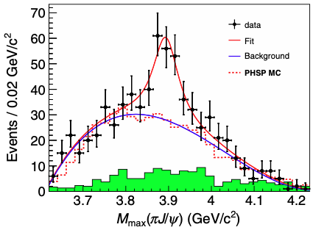
Zc states
BESIII Collaboration
BelIe Collaboration

Slide 25
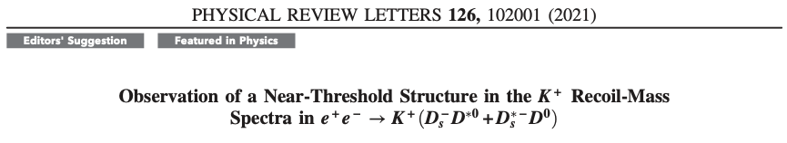
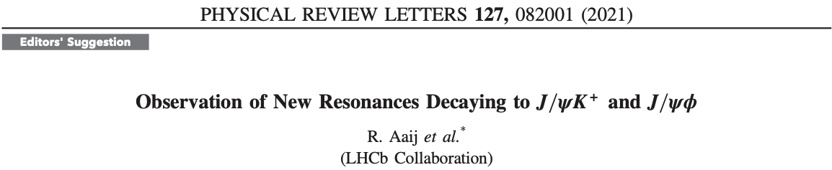
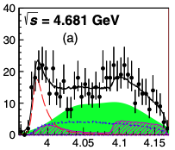
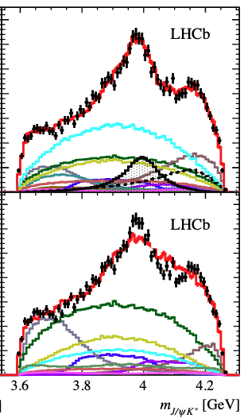
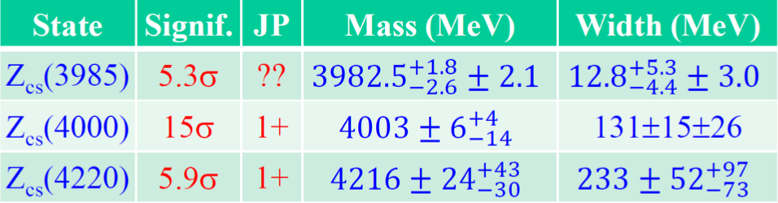
Zcs states
BESIII Collaboration

Slide 26
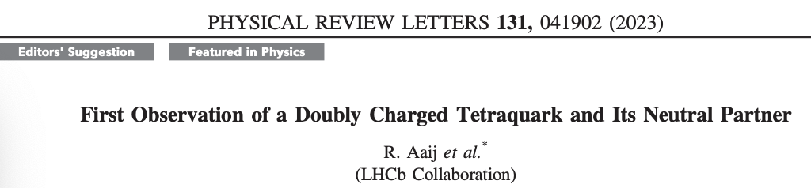
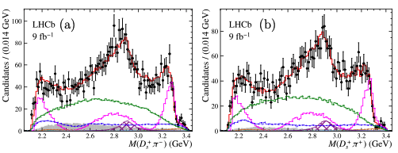
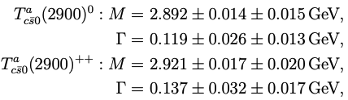

Slide 27
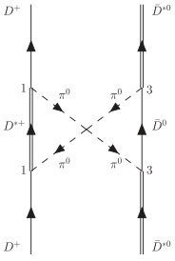
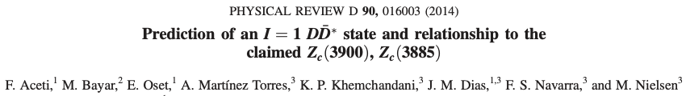
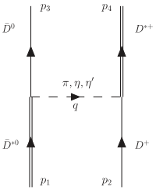
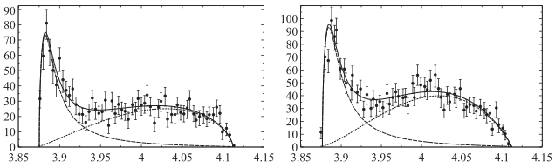
Theoretical investigation
Zc states
One pseudoscalar exchange
two pion exchange

Slide 28
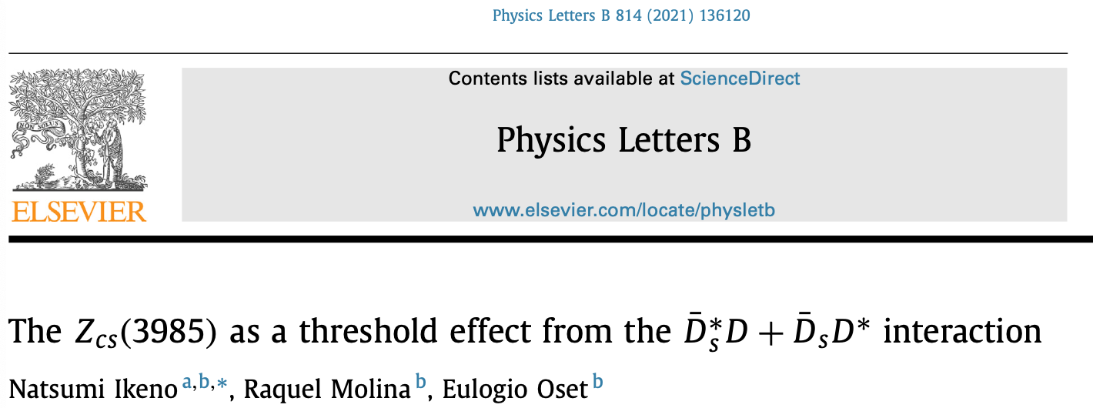
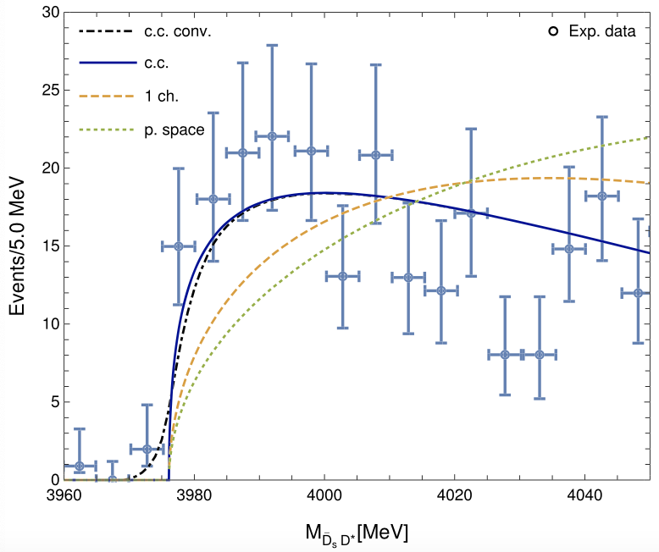
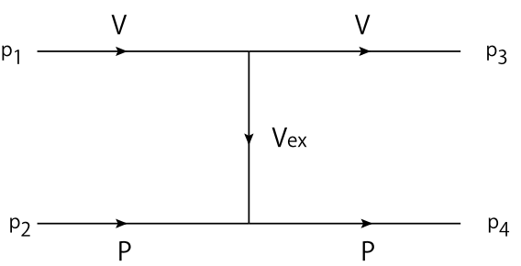
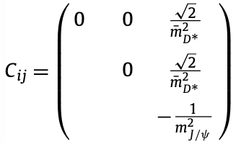

Zcs states

Slide 29





Slide 30




Progr. Phys. 41 (2021) 65

Slide 31





We try to investigate……
On going

Slide 32











Slide 33






Slide 34

Primary

Slide 35




Slide 36

Primary
Further investigation….

Slide 37



§4. Summary
The origin of the mass differences of
Are there also existing two Pcs states
From the view of molecular state, what components are for
Also what components are for Pc(4337)
Are there more XYZ states as our predictions?
$$?$$
Hope future experiments and theories bring more clarifications on these issues…….

Slide 38
Thanks for your attention!
感谢大家的聆听！

